Slide 1
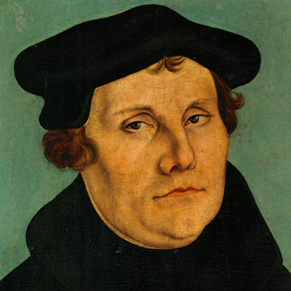
Martin Luther
1483-1546
See More At http://www.TheRestorationMovement.com/
Notes:
Not the first reformer, but certainly the most prominent – potentially for his writings. If anyone could be said to have born for such a time as this, Luther fits the criteria, for certain.
When Martin was born in Germany, reformer, John Wycliffe of England had been dead for 99 years. It had been 68 years since Bohemian Reformer, Jan Hus was burned at the stake. At the age of 15, Dominican Monk, Girolamo Savonarola, and two of his fellow monks were burned at the stake in Florence, Italy for espousing reformatory ideas.
29 years before he was born the Guttenburg press was in production, printing the first Bibles ever to be mass produced. And, 29 years after he was born, Michaelango completed the paint of the ceiling of the Sistine Chapel in Rome.
He was born at a prime time in world history for change to take place in the thinking and actions of the people of Europe.

Slide 2
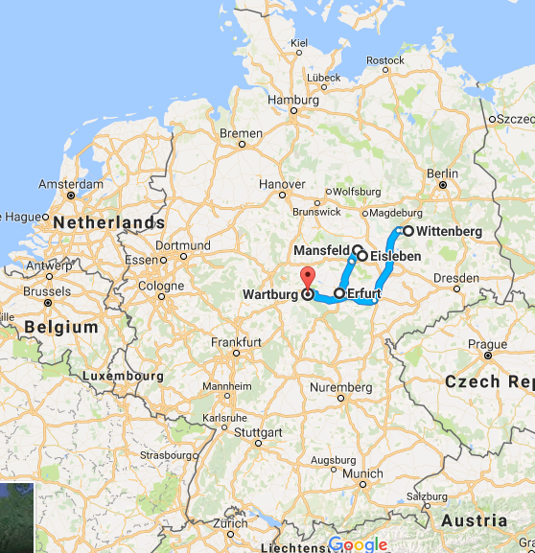
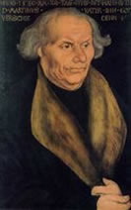
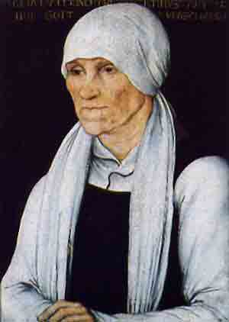
the Life of Martin Luther
Born Eisleben, Germany - November 10, 1483
Luther’s parents, Hans and Margaretha Luder moved to Mansfeld in 1484 where Hans worked in a copper mine, later owning it.
Source: Google Maps
See More At http://www.TheRestorationMovement.com/

Slide 3
the Life of Martin Luther
From 1492 to 1505 Luther University of Erfurt, Germany to study law. Acquired BA & MA.
On July 2, 1505, at age 21, during a thunderstorm, Luther cried: “Help me St. Anne, I will become a monk!”
Within a month, enters the Order of Augustinian Monks.
See More At http://www.TheRestorationMovement.com/

Slide 4
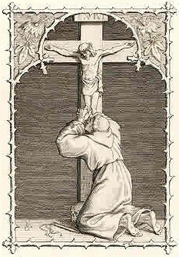
The Life of Martin LuThER
Tormented by sensitivity to sin nature
Extreme asceticism: prayer, fasts, sleep deprivation, cold, whipping himself
Constantly in confession
Luther: “If ever a monk got to heaven by his monkery, I was that monk!”
See More At http://www.TheRestorationMovement.com/

Slide 5
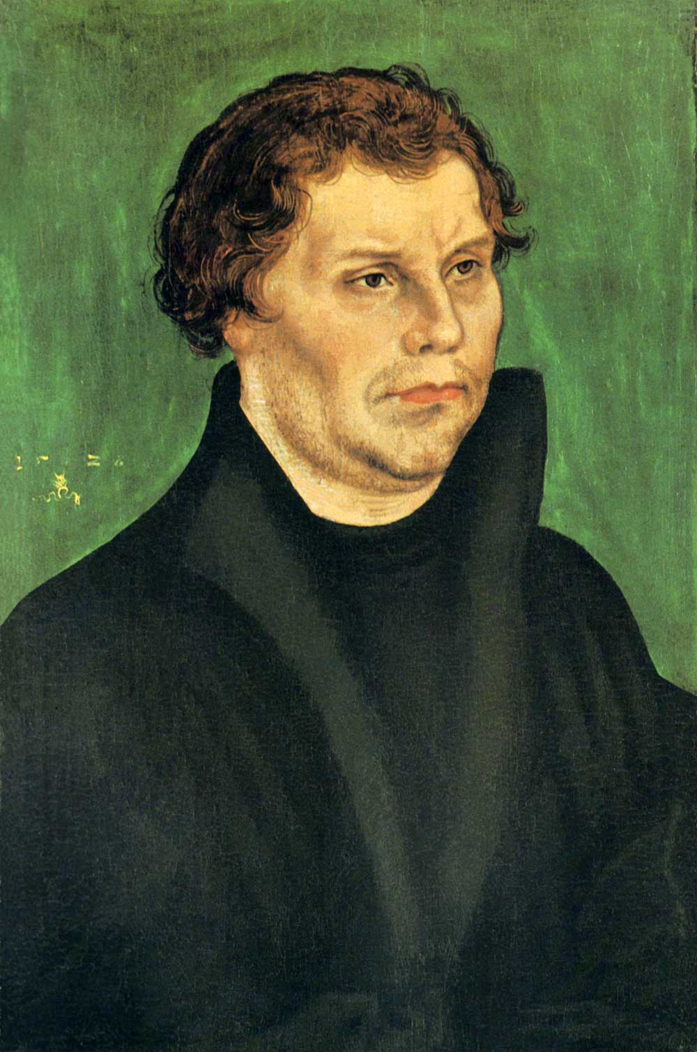
the Life of Martin Luther
May 2, 1507 – Luther was ordained a priest
In 1509, Luther earned Bachelor of the Bible and in 1512 he reached the terminal degree: Doctor of theology.
Between 1513 and 1517, Luther lectured at University of Wittenburg on the Psalms, Romans, Galatians
Young Luther
See More At http://www.TheRestorationMovement.com/

Slide 6
the Life of Martin Luther
1515, great discovery: Rom. 1:17
Gospel is revelation of justice of God
To Luther, justice of God was unbearable; yet, Gospel linked to God’s justice
Justice does not refer to punishment of sinners; righteousness is given to those who live by faith
Justification is the free gift of God to sinners: righteousness is imputed by God who justifies humans by their faith in Jesus Christ
See More At http://www.TheRestorationMovement.com/

Slide 7
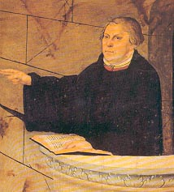
the Life of Martin Luther
“Here I felt as if I were entirely born again and had entered paradise itself through gates that had been flung open. The whole of Scripture gained a new meaning. And from that point on the phrase the ‘justice of God’ no longer filled me with hatred, but rather became unspeakably sweet by virtue of a great love.” –Martin Luther
See More At http://www.TheRestorationMovement.com/

Slide 8
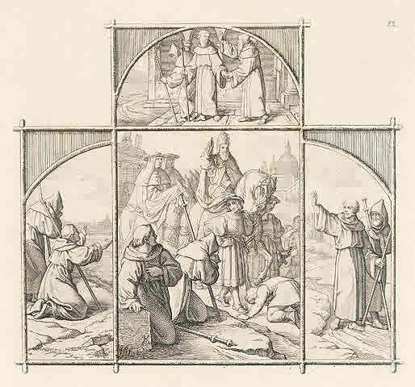
Martin Luther’s Trip to Rome
1511 – Augustinian Abbot Staupitz sent Luther on a pilgrimage to Rome
He visited the holiest places; crawled up Pilate’s staircase
Luther observed priests & bishops acting immorally & abusing their power
Luther: “I went with onions & returned with garlic”

Slide 9
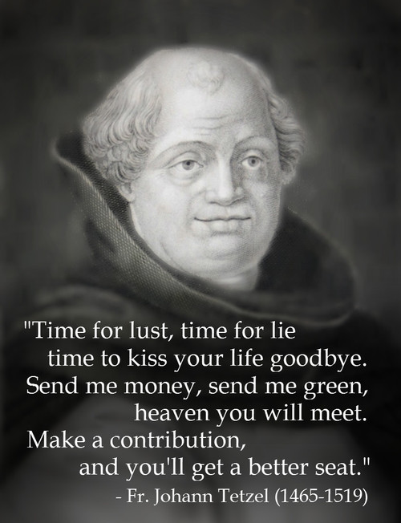
the Life of Martin Luther
During this time, Albert of Brandenburg bought electorship and archbishopric of Mainz. He hired John Tetzel of Mainz to sell indulgences (a rem. of punishment for sins).
The sale of indulgences was part of a fund-raising campaign commissioned by Pope Leo X to finance the renovation of St. Peter’s Basilica in Rome.
John Tetzel
Notes:
Tetzel: “As soon as a coin in the coffer rings, a soul from purgatory springs.”
“Time for lust, time for lie, time to kiss your life goodbye. Send me money, send me green, heaven you will meet. May a contribution, and you’ll get a better seat.”
Story of Tetzel’s vanity – The sale of an indulgence for sin yet to be committed. He was told the payment would be double. Later he was robbed while making his way to another appointment. The bandit showed his indulgence.

Slide 10
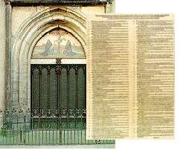
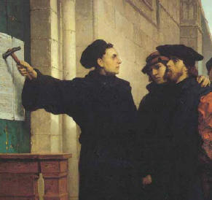
the Life of Martin Luther
On October 31, 1517, Luther posted 95 Theses (Disputes) on the door of All Saints’ Church in Wittenburg protesting clerical abuses and the sale of indulgences.
Called the birth date of the Protestant Reformation
See More At http://www.TheRestorationMovement.com/
Notes:
“In crisp, vigorous language Luther challenged the indulgences. He protested against despoiling Germans to pay for the construction of St. Peter’s, saying that few Germans could worship there, that the Pope was rich enough to do the building with his own money, and that he would do better to appoint one good pastor to a church than to give indulgences to them all. Luther said that indulgences did not remove guilt and that the Pope could remit only those penalties which he himself had imposed on earth and that he had no jurisdiction over purgatory. He denied that the saints had accumulated surplus credits. He held that indulgences bred a false sense of security and so were positively harmful.
“To Luther’s surprise, the ninety-five theses created an immense sensation. Within a few months they were printed in the Latin original and in a vernacular translation and were being read across Germany. That they had this effect was due in part to the skill and forthrightness with which Luther drafted them. It was even more because of an underlying restlessness which hailed them as saying what many were happy to have said. As a result, Luther was drawn into controversy. Although at the outset he had no thought of breaking with the Pope or the Church of Rome, he was not one to draw back, and prudence and guarded speech were alien to his nature. In the course of the debate he was led on step by step until he had declared that both Popes and general councils of the Church could err, that only the Scriptures are authoritative, and that he would concede that he was in error only if convinced that what he held was contrary to the Bible and to sound reason. In effect he was insisting upon the right and the duty of individual judgement which must not be surrendered, even to the Catholic Church.” A History of Christianity, Vol. 2, Kenneth Latourette, page 709.

Slide 11
Selections from 95 Theses
32. Those who suppose that on account of their letters of indulgence they are sure of salvation will be eternally damned along with their teachers.
36. Every Christian who truly repents has plenary (full) forgiveness both of punishment and guilt bestowed upon him, even without letters of indulgence.
37. Every true Christian, whether living or dead, has a share in all the benefits of Christ and the Church, for God has granted him these, even without letters of indulgence.

Slide 12
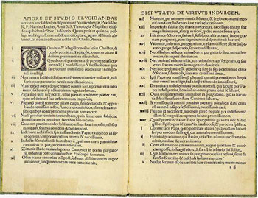
Selections from 95 Theses
81. This shameless preaching of pardons makes it hard even for learned men to defend the pope’s honor against calumny (slander) or to answer the indubitably shrewd questions of the laity.
82. For example: “Why does not the pope empty purgatory for the sake of holy love . . . For after all, he does release countless souls for the sake of sordid money contributed for the building of a cathedral? . . .”

Slide 13
the Life of Martin Luther
4 Attempts To Silence Luther
4.25.1518 – Heidelburg Disputation
Leo X offered Luther a Cardinalship
1518 - Cardinal Thomas Cajetan, Dominican papal legate, was sent to stifle Luther
07.1519 – Leipzig Debate with John Eck
Cajetan (left) Luther (right)
Source: Public Domain, https://commons.wikimedia.org /w/index.php?curid=552755
See More At http://www.TheRestorationMovement.com/
Notes:
FOUR ATTEMPTS TO SILENCE LUTHER
1. Heidelberg Disputation (May 1518)
Luther was put on trial before Augustinian General Council
Introduced “Theology of the Cross”:
Centrality of Cross
Only Jesus can forgive sins
Be willing to become nothing for God’s glory
Attacked scholastic theology, which he called “Theology of Glory” – those who hate the cross & love works in order to obtain earthly glory
Martin Bucer, reformer of Strasbourg, attended & was persuaded Johann Eck, lawyer and firm defender of the Catholic cause was in attendance – led to Leipzig Debate
Leo X offered Luther position of Cardinal if he would be silent – He said, “How dare they try to buy me off!”
Cardinal Cajetan, Dominican papal legate, was sent to stifle Luther at Diet Of Augsburg -
Luther presented written arguments
-Pope was not infallible
-Authority of council was superior to pope
-Sacraments apart from faith cannot save
-Justification by faith was scriptural
-Appealed to Bible as supreme authority
Cajetan published order for Luther’s arrest
Leipzig Disputation (July 1519)
John Maier of Eck vs. Luther
Luther bested Eck through citation of Scripture by memory to prove that Christ, not pope, is head of church
Eck accused Luther of being “Saxon Huss” (after Bohemian reformer John Huss (1369-1415)
At first Luther denied charge; during intermission, he researched Huss; came back to say: “We are all Hussites if we believe the Bible to be true”
Luther’s affirmation of Huss, convicted heretic, was a dangerous admission

Slide 14
the Life of Martin Luther
Why was Luther not killed in order to silence him?
He was protected by Frederick the Wise, (Frederick III, Saxony) who was able to manipulate pope & emperor
Source: By Lucas Cranach the Elder - liechtensteinmuseum.at, Public Domain, https://commons.wikimedia.org/w/index.php?curid=5235433
See More At http://www.TheRestorationMovement.com/

Slide 15
the Life of Martin Luther
In 1518 and 1519, Luther defended his theology and debated Professor Eck at Leipzig where he denied the supreme authority of popes and councils.
In 1520, the Pope issues a bull of excommunication at Luther, giving him 60 days to recant.
Luther responds with three significant writings defining his beliefs.
See More At http://www.TheRestorationMovement.com/
Notes:
The papal bull begins as follows, “Arise, O Lord, and judge thy cause! Remember the reproach which the foolish cast against Thee all day long! St. Peter, St. Paul, the congregation of saint, and the church are called upon to arise. The foxes would lay waste the vineyard of the Lord; a wild boar has entered therein; a savage beast would pasture there.” Then forty-one of Luther’s theses are considered and condemned as heretical. He himself is called upon to recant within sixty days. If he and his followers refuse, they will be treated as heretics. His writings are to be burned, so that his remembrance shall be totally blotted out of the congregation of Christian believers. All intercourse with him and his adherents is forbidden. Every one is commanded to seize Martin Luther and deliver him to the Pope in Rome. There he shall be dealt with according to law.” The Life of Martin Luther, by Dr. William Rein, Seminary Director at Eisenach in Germany, c.1883, page 76

Slide 16
Source:By Karl Aspelin 1857-1922 - www.uppsalaauktion.se, Public Domain, https://commons.wikimedia.org/w/index.php?curid=7528858
Luther Burns the Papal Bull – 12.15.1520
Saying “Since they burn my books, I burn theirs!”

Slide 17
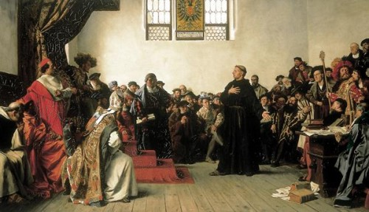
the Life of Martin Luther
1521 – Diet of Worms - Luther is excommunicated & condemned as a heretic and outlaw.
Source: Wikipedia.com
See More At http://www.TheRestorationMovement.com/

Slide 18
the Life of Martin Luther
Fredrick the Wise rescued Luther and protected him at Wartburg castle, where Luther began to translate the New Testament into German.
Source: Wikipedia.com
See More At http://www.TheRestorationMovement.com/

Slide 19
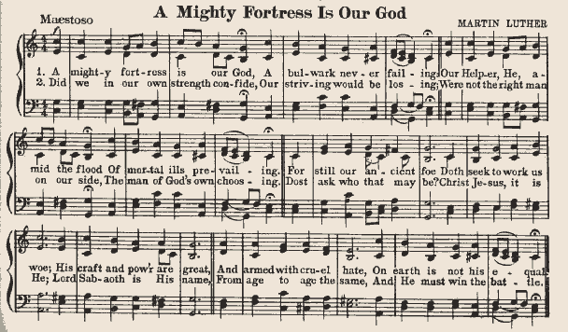
the Life of Martin Luther
Between 1523 and 1529, Luther continued his writings, including Bondage of the Will, Large Catechism and Small Catechism and the hymn, A Mighty Fortress Is Our God.

Slide 20
the Life of Martin Luther
In 1523, Luther helped eleven nuns escape a cloister by hiding them in empty herring barrels.
In 1525 he married one of these nuns, Katherine von Bora. They would have six children together.
Source: Wikipedia.com
Katarina von Bora
(1499-1552)

Slide 21
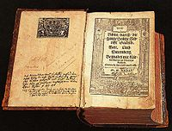
the Life of Martin Luther
In 1534, Luther published the entire Bible in German.
Source: Wikipedia.com
See More At http://www.TheRestorationMovement.com/

Slide 22
the Life of Martin Luther
He continued writing, teaching and lecturing until he died on February 18, 1546.
Said, “When I die, I’m going to come back as a ghost & haunt the popes & his bishops. They’ll have far more trouble with the dead Luther than they ever had with the live one.”
Source: Wikipedia.com
See More At http://www.TheRestorationMovement.com/

Slide 23
Martin Luther’s Successor
Philip Melanchthon was named successor
Real name: Schwarzerd, “Black Earth”, Greek: melan chthon
Attended Marbourg Colloquy; co-authored Augsburg Confession
Philip Melanchthon
Source: By Lucas Cranach the Elder - Staatliche Kunsthalle Karlsruhe, Public Domain, https://commons.wikimedia.org/w/index.php?curid=465247
See More At http://www.TheRestorationMovement.com/

Slide 24
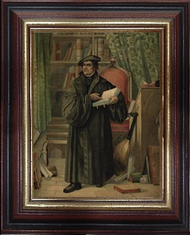
Martin Luther’s Legacy
Salvation: justification by grace through faith
Lord’s Supper: consubstantiation – Christ’s presence with the elements
Priesthood of the believer
Union of church & state – to retain support of German princes
“Father Of The Reformation”
See More At http://www.TheRestorationMovement.com/

Slide 25
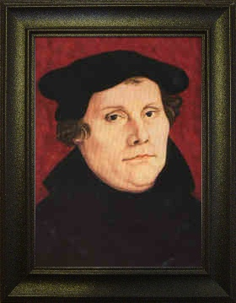
Martin Luther’s Legacy
Principles of Reformation
Sola Scriptura
Sola Fide
Sola Gratia
Sola Christus
See More At http://www.TheRestorationMovement.com/

